Slide 1
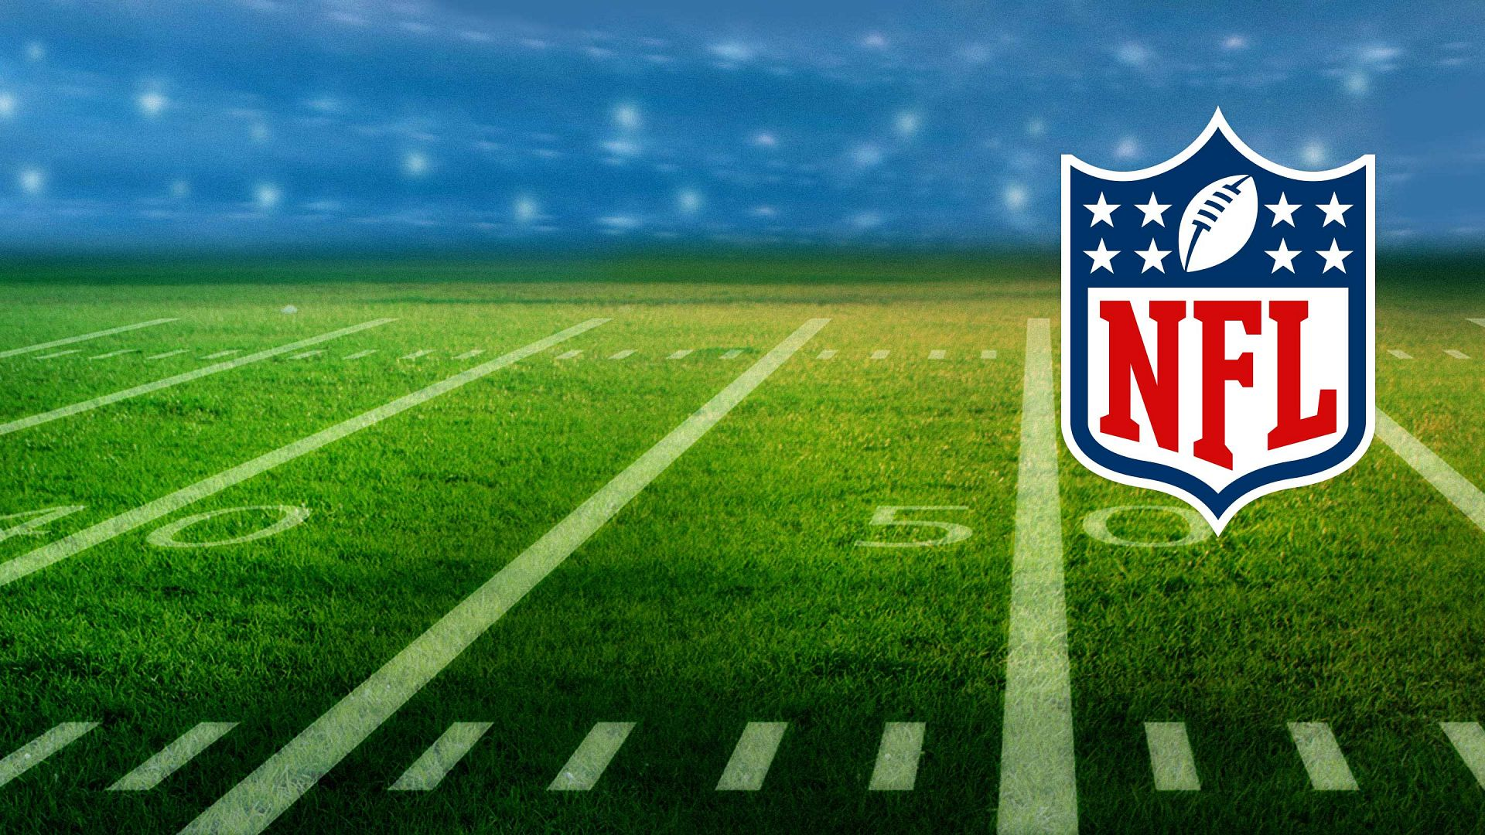
Outsmarting Elo
Can we predict National Football League game outcomes better than FiveThirtyEight’s Elo forecasting algorithm?

Slide 2
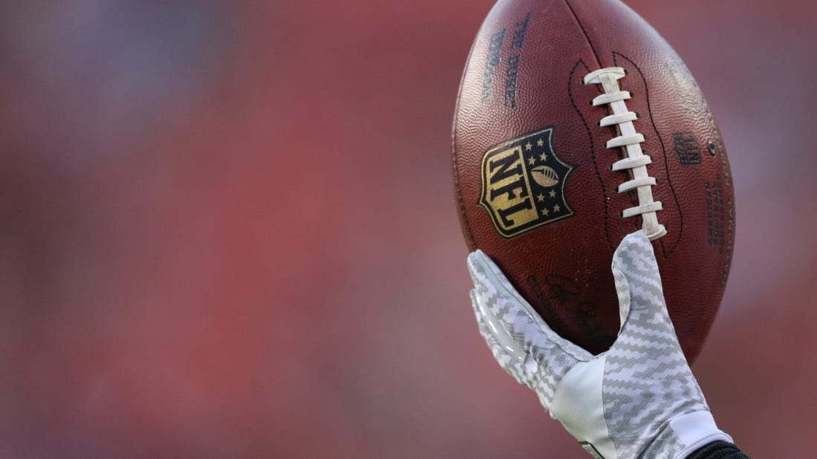
What’s Elo and what’s its relationship to the NFL?
Elo is a simple system developed by physicist Arpad Elo to rate chess players.
The system can be adapted for other head-to-head competitions between teams or individuals.
The data journalism website, FiveThirtyEight.com, applied the Elo rating system to American Football to forecast outcomes of NFL games.
FiveThirtyEight.com hosts an NFL predictions game on its website and challenges readers to attempt to best its Elo algorithm.

Slide 3
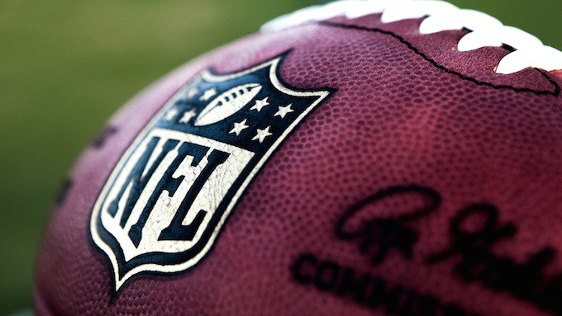
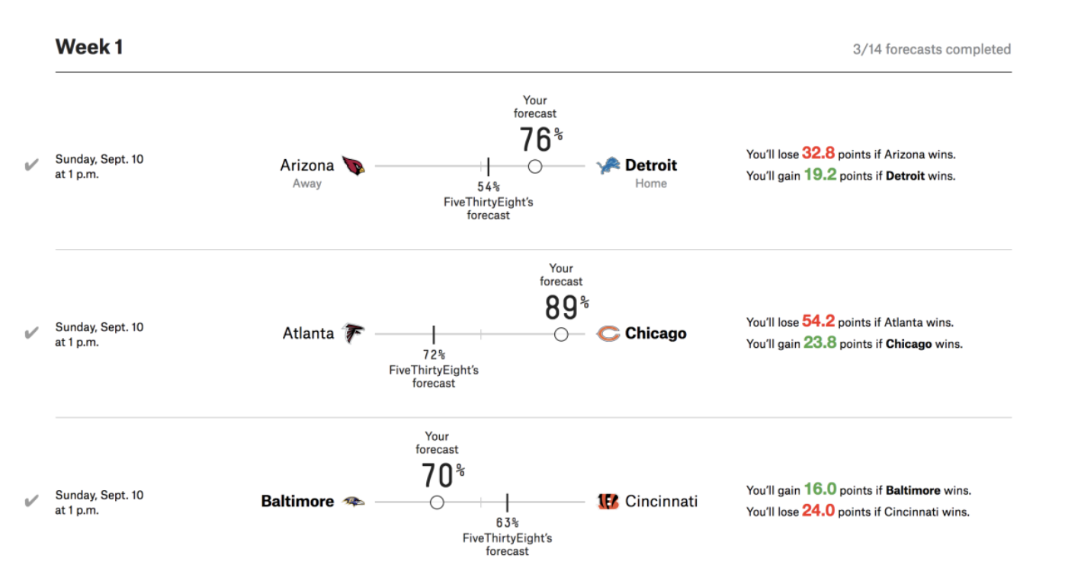
How does the NFL predictions game work?
Players make a probabilistic forecast for each game, picking the winning team and how confident, via percentage, they are in their projection.
Points are earned for correct predictions and lost for incorrect predictions.
The higher the confidence assigned to the winning team, the more points are awarded or lost.

Slide 4
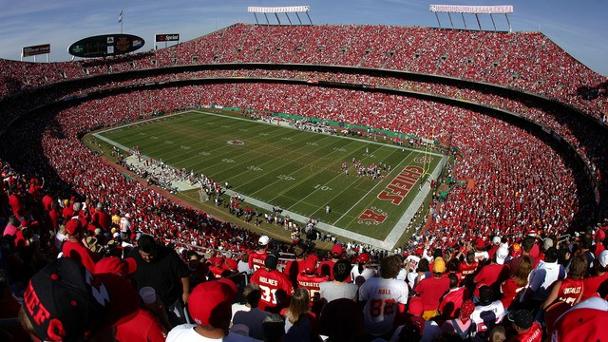
How does FiveThirtyEight’s Elo algorithm fare?
2018 – Finished in 701st place, beating 95% of the game’s players.
2017 – Finished in 432nd place, beating 98% of the game’s players.

Slide 5
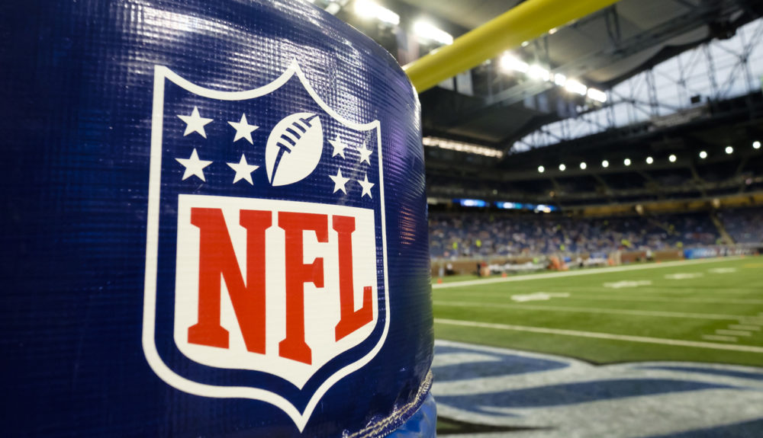
Our goal: create a machine learning model that beats FiveThirtyEight’s Elo algorithm in the NFL prediction game.
We analyzed weather, stadium, betting, and game outcome data from https://www.kaggle.com/tobycrabtree/nfl-scores-and-betting-data. The site’s data was derived from ESPN.com, NFL.com, the Pro Football Reference, NOAA, and NFLweather.com.
We gathered additional betting data from http://www.repole.com/sun4cast/data.html for the 1978-2013 seasons and sportsline.com for the seasons after 2013.
The ELO data comes from FiveThirtyEight’s NFL Forecasting game, https://github.com/fivethirtyeight/nfl-elo-g.
After researching several factors that affect NFL game outcomes, we decided to merge the Elo algorithm with Vegas betting probabilities, assigning a percentage to the betting odds based on the moneyline—Vegas’s odds on who will win an NFL game outright.
We assigned equal weight to the Elo and Vegas models and combined them to create a new model, Group 8.

Slide 6
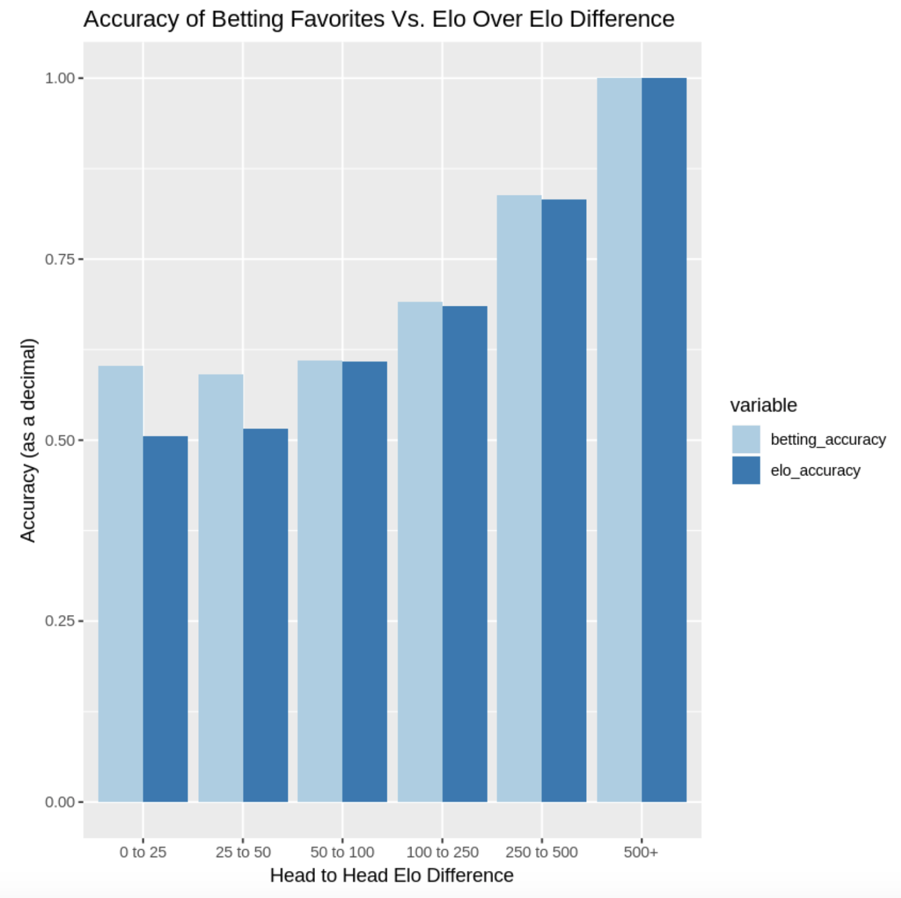
We looked at the accuracy of Vegas betting favorites in selecting NFL game winners versus Elo’s accuracy. Based on this data, we decided to combine betting data with the Elo model to create the Group 8 model.

Slide 7
NFL Prediction Game Points: 2001 - 2017
Season | Group 8 | Vegas | FiveThirtyEight
2001 | 567 | 474 | 532
2002 | 834 | 834 | 719
2003 | 855 | 796 | 784
2004 | 878 | 907 | 702
2005 | 1241 | 1325 | 1037
2006 | 482 | 410 | 407
2007 | 1102 | 1080 | 935
2008 | 932 | 844 | 852
2009 | 1140 | 863 | 1200
2010 | 662 | 740 | 435
2011 | 1063 | 926 | 1003
2012 | 1020 | 1065 | 831
2013 | 1040 | 1002 | 920
2014 | 1246 | 1114 | 1199
2015 | 692 | 539 | 674
2016 | 996 | 958 | 885
2017 | 1080 | 1143 | 867
Total Score | 15830 | 15020 | 13982
Average Score | 931.18 | 883.53 | 822.47
Seasons Won | 10.5 | 5.5 | 1
From 2001-2017, the Group 8 model outperformed
FiveThirtyEight’s model and Vegas odds, winning 10 of 17 seasons and tying one.

Slide 8
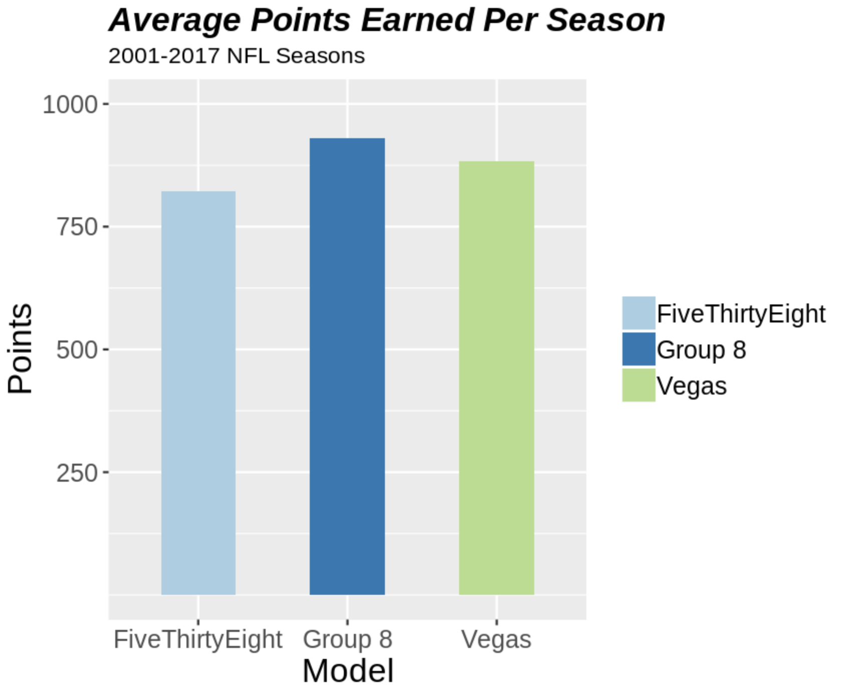
The Group 8 model averaged more points per season over 17 seasons than the Vegas or FiveThirtyEight models.

Slide 9
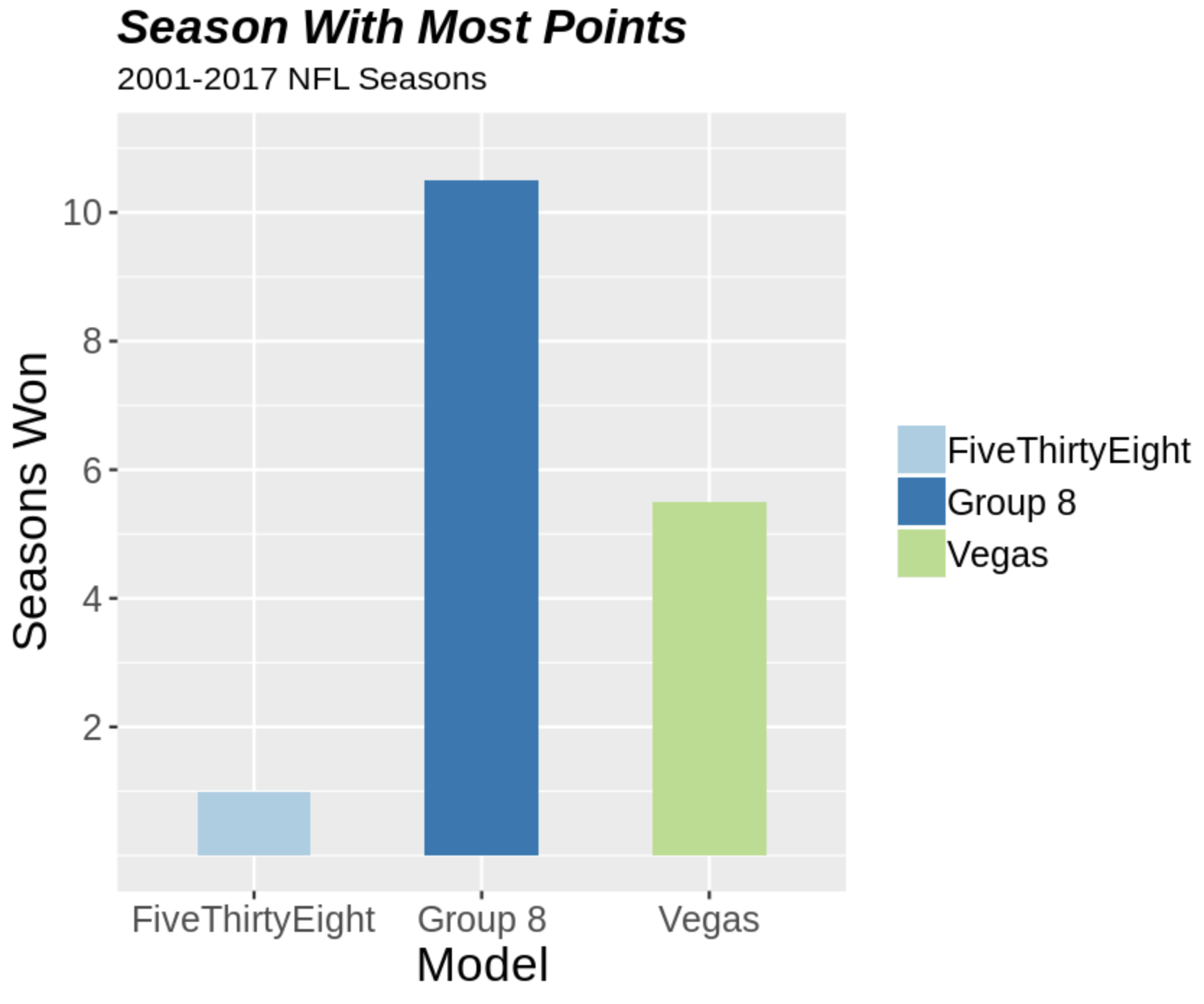
The Group 8 model earned more NFL prediction game points than the competing models during 10 of 17 seasons, and it tied the Vegas model during one season.

Slide 10
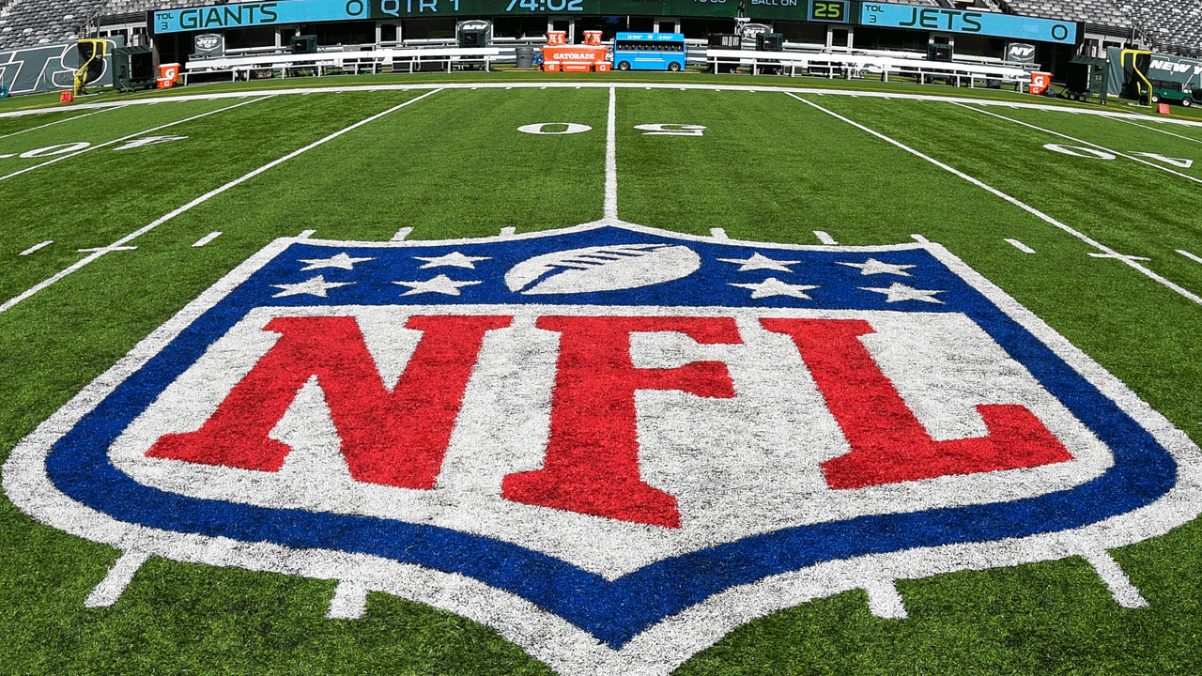
The Bottom Line
Just like in football, the scoreboard tells the story. Our Group 8 model outperforms FiveThirtyEight’s Elo algorithm and Vegas betting probabilities in FiveThirtyEight.com’s NFL prediction game.
Gamblers can use the Group 8 model to place bets, particularly on moneyline bets that appear to significantly overestimate or underestimate the favorite’s chances according to the model.
Casual fans can use the Group 8 model to win NFL pick’em pools played among coworkers and friends.

Slide 11
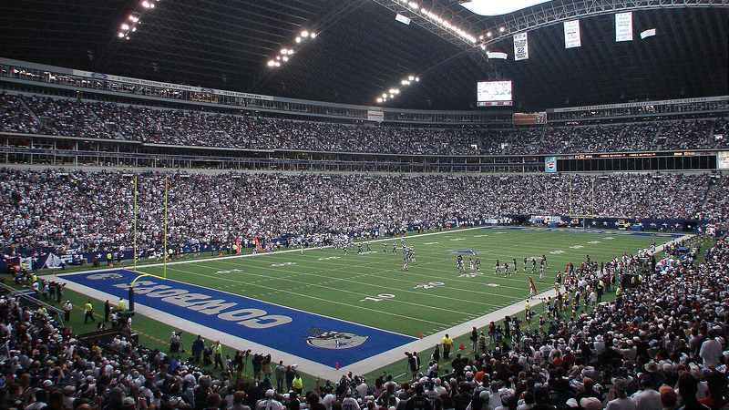
What now?
We will compete in the NFL predictions game on FiveThirtyEight.com and see how are model performs during the 2019 NFL season.
Can you beat the Group 8 model? We invite you to play along with us. You can register to play the game for the 2019 NFL season https://projects.fivethirtyeight.com/2018-nfl-forecasting-game/.

